Slide 1
Important Factors to Evaluate when Entering the Film Industry - A Microsoft Perspective

Slide 2

Overview and Business Problem
The examination focuses on key strategies to adopt in order to penetrate the film-making realm.
Attention is on distinct sectors on which to emphasize and put resources in.
The assessment aims at identifying favorable opportunities carrying minimal risk -by focusing on preferred genres.
The brand faces a specific problem-concern - how to penetrate this new industry.
Key datasets to utilize include: -
df_moviegross
movie_budget
basics_title
ratings_title
movies_df
The most appropriate datasets are selected as they entail valuable information.
The information is crucial during the first decision-making phase.
The datasets are crucial to addressing these inquiries:
What are the primary opportunities and patterns in the film industry?
Are there any niche markets or underserved audience segment that are worth exploring?
How much funding is required to cover movie production and operational expenses?
What are the potential revenue from movie releases and other income streams?
What are the projected returns on investment, and what is the expected payback period?
What genres, budget ranges, and target audiences does the studio plan to focus on for movie production?

Slide 3
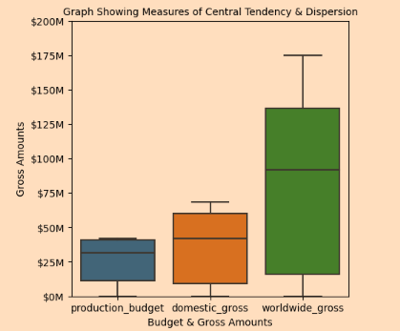
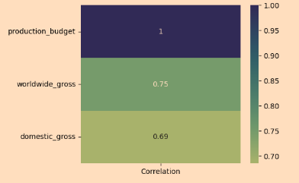
Data Analysis & Visualization
Encompasses the utilization of statistical information gained from existing data sets.
The derived information includes variation, dispersions, and central tendency.
Visualization of values attained via Seaborn or Matplotlib libraries.
Visualizations can be frequency tables, pie charts, or bar graphs amongst others: like shown below.
The Graph shows the relationship between domestic gross amount, worldwide gross amount, and production budget.

Slide 4
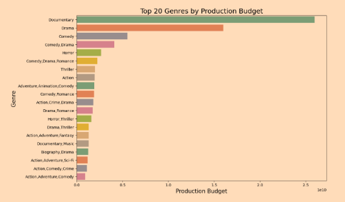
Relationship Between the Production Budget and Genre

Slide 5
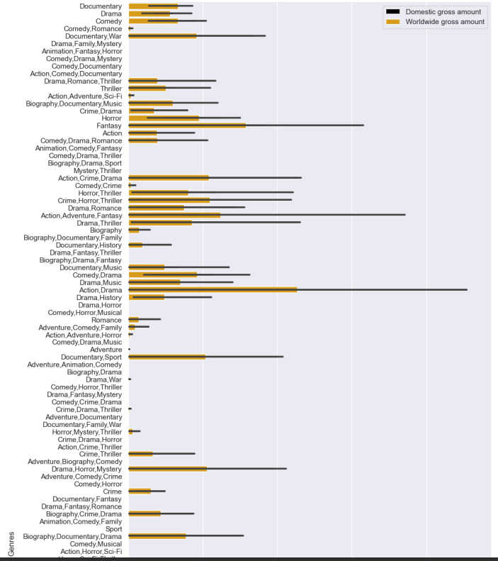
Relationship Between Domestic Gross, Worldwide Gross and Genre

Slide 6
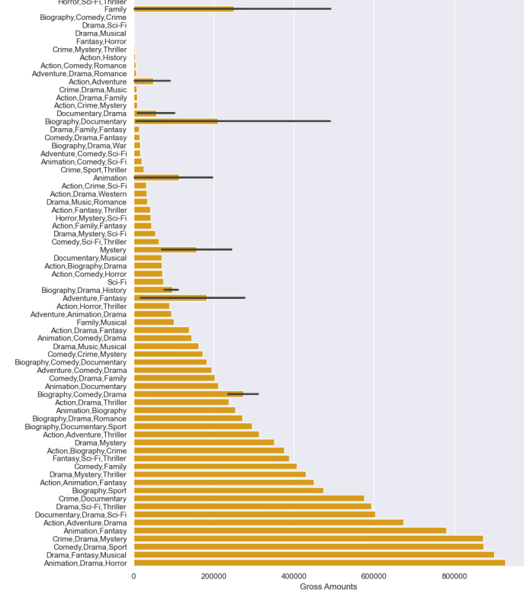
Relationship Between Best Rating and Genre

Slide 7
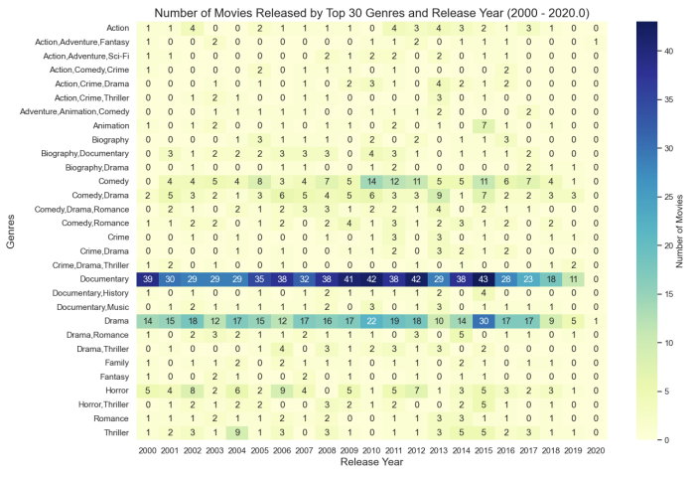
Relationship Between Release Date and Genre

Slide 8
Evaluation
The above presented visualizations provide several insights.
These insights include:
For any movie under production, it is recommended to possess an average production budget of roughly $31.588 million.
Positive impact on return on investment from high production budgets - both domestic and the worldwide gross amounts.
Genres such as romance, horror, comedy, and drama project a combination of high film ratings and high production budgets.
These aforementioned genres remained untapped by Microsoft,hence, providing a viable niche for subsequent production
The genres having the highest ratings include romance, comedy, horror, science fiction, adventure, animation, and drama.
Future Strategy to Incorporate
After determining the initial genre direction , as a starting point for movie production, there is a need for additional research aimed at identifying the most suitable movies crew.
The aim of having the best movie crew is to enhance the film’s overall chances of success.
It is also vital to conduct further studies aiming to identify the most optimal timing for movie releases.
The investigation assists in determining the most favorable time frames - so as to maximize potential audience reach and impact of the film on targeted audiences.

Slide 9
Recommendations
The following recommendations to Microsoft are critical, grounded on the aforementioned evaluation:
Microsoft ought to allocate a budget of at the very least $31.588 million to cover all production costs including operational expenditure. The studie, by doing so, enhances its chances of attaining high returns on investments - both globally and domestically.
Microsoft should consider the viability of investing in the following genres: drama, adventure, romance, and animation. These genres continue receiving favorable ratings, thereby, providing the new studio with better opportunities for both audience engagement and effective film marketing.
Microsoft, as a startup, should focus on those genres having relatively fewer productions. The approach may potentially assist the new studio to venture out and carve out its niche market, thereby, leading to potential recognition and success.
Lastly, for Microsoft Studio to maximize profits, the brand should not be limited in terms of focus on the domestic American market only. Rather, expansion into the international marketplace is key to not only global recognition but also more substantial returns on their movie production.

